Slide 1






a short introduction to
2019-12-05 spraakbanken.gu.se

Slide 2
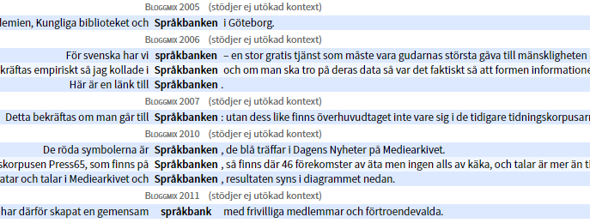
Overview
What is Språkbanken?
Our resources
Our tools
Some example applications
To do together

Slide 3
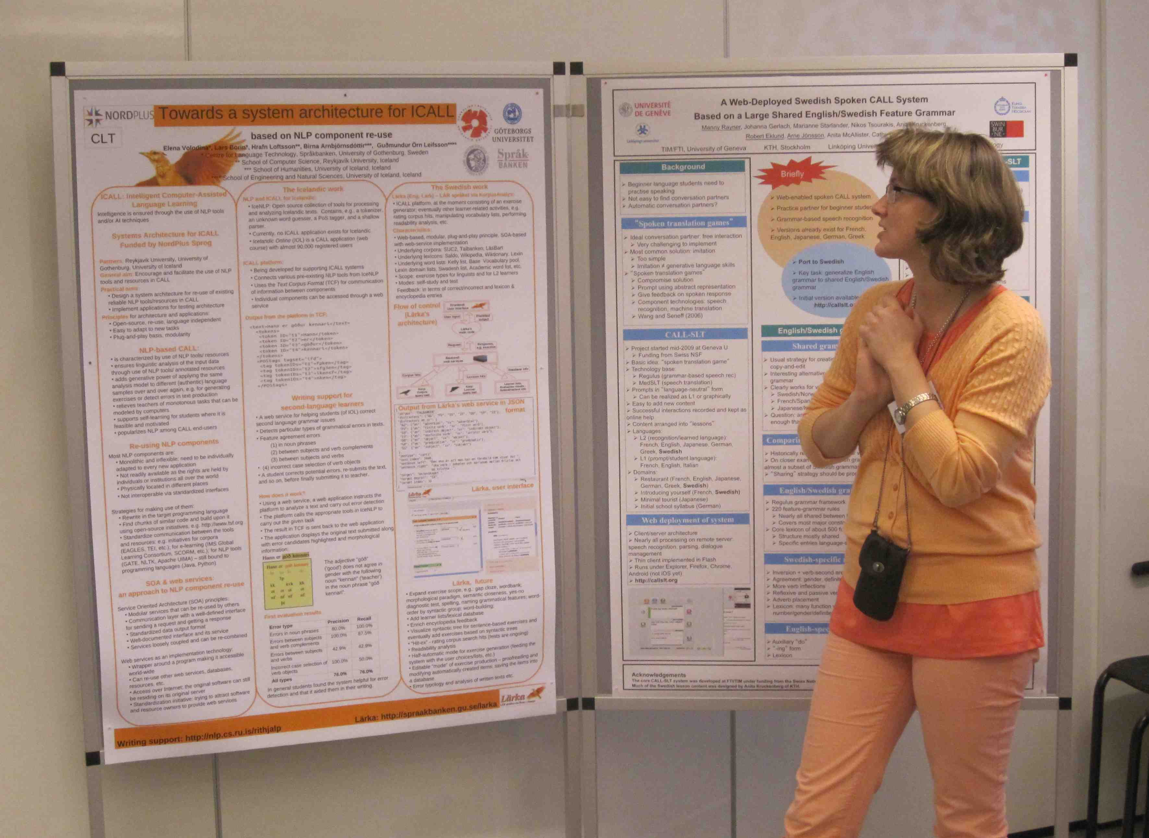
What Is språkbanken?
Photo: Lene Antonsen

Slide 4
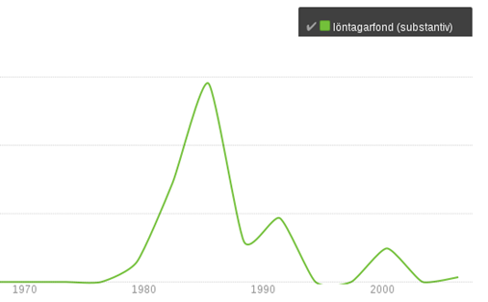
What is Språkbanken?
A bank generates profit
Språkbanken generates knowledge

Slide 5
Who needs Språkbanken?
Scientists, organisations, companies who are working with human communication, e.g.
computer scientists
philologists
gender scientists
historians
health scientists
cultural scientists
linguists
literary scholars
media scientists
pedagogues
psychologists
social anthropologists
language technologists
political scientists
etc.

Slide 6
The different flavours of Språkbanken
Nationella språkbanken is a national research infrastructure that is financed by Vetenskapsrådet and 10 universities and governmental agencies
It consists of three divisions: Språkbanken Sam, Språkbanken Tal and Språkbanken Text
This presentation is about Språkbanken Text, which is working with written language data

Slide 7

Our resources 600+ corpora 57 lexica

Slide 8
What is a corpus?
A corpus is a large digital collection of texts that can be used for, e.g., searching or training AI models
To improve the usefulness, corpora are usually annotated, e.g.
morphological information (boken is a noun in singular definite form, and is the same word as bok, böcker and böckerna)
syntactic (bok is the object in jag läser en bok)
semantic information (what is the meaning of the word bok in this sentence – a written text, or a tree?)
metadata (what kind of text is it? who wrote the text? when?)
The annotation is most often made automatically by computer algorithms (and therefore contains errors)

Slide 9
Some of Språkbanken’s corpora
Användningsexempel kommer snart!
Novels
Newspapers
Journals
Sociala media
blogs
discussion forums
Twitter
Governmental texts
Wikipedia
Finland Swedish
Historical texts
Old Swedish
Modern Swedish
Parallel texts
the same texts in 25+ languages
Gigaword
a large balanced corpus of vairous genres from 1950 onwards

Slide 10
Some of Språkbanken’s lexica
Användningsexempel kommer snart!
SALDO: a semantic and morphological dictionary
Hellquist's Swedish etymological dictionary
Blissymbolics dictionary
Schlyter's and Söderwall's dictionaries of medieval Swedish
Sentiment lexicon
Dictionary of loan words
Swesaurus: a Swedish WordNet, a Swedish concept lexicon
SweFN++: a Swedish FrameNet, a database over semantic frames
Our lexica are created to be used for automatic text analysis

Slide 11
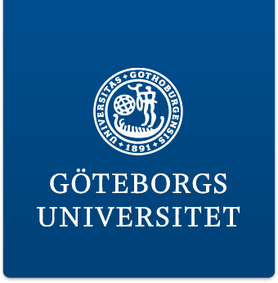

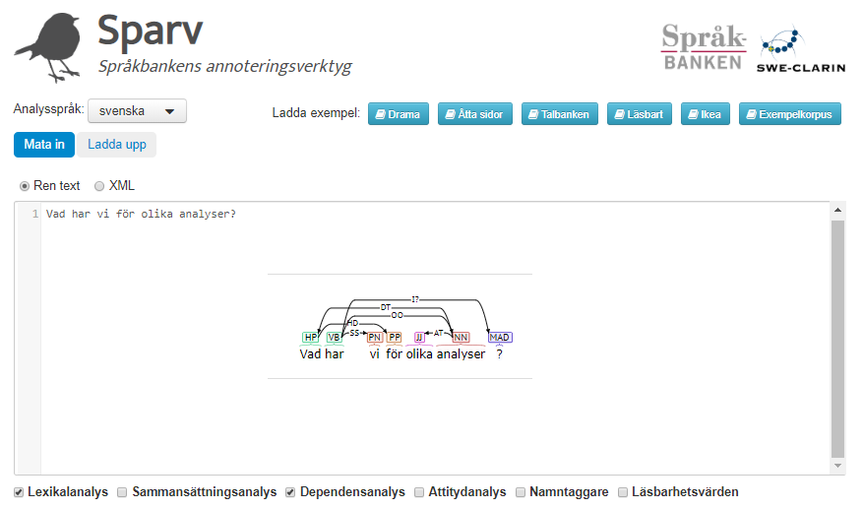
Our tools

Slide 12
Our most important tools
Korp: a search engine that provides access to about 15 billion words of Språkbanken’s corpora
Karp: a tool for working with Språkbanken’s lexica
Sparv: an tool that annotates texts with morphological, syntactic and semantic information
Strix: a document-oriented search engine that can take a document's semantic content in account (in contrast to Korp which is word-oriented)
Lärka: a platform for second language learning and second language research

Slide 13
Korp
Korp is a search engine
intended for investigating linguistic phenomena
https://spraakbanken.gu.se/korp

Slide 14
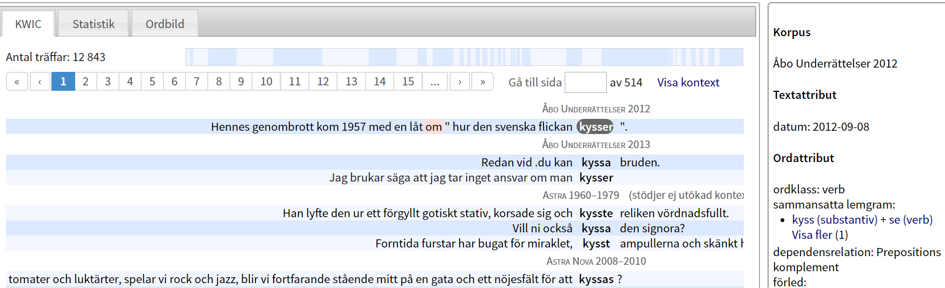
Korp – word search (KWIC = keywords in context)
gives information about the frequency of the word, showing its occurrences in context, here’s an example for the word kyssa
Info about corpus
Frequency
Name of corpus
Info about word
Examp
l
e
s
WRONG! Stupid computer!

Slide 15
Korp – other possibilities

Slide 16
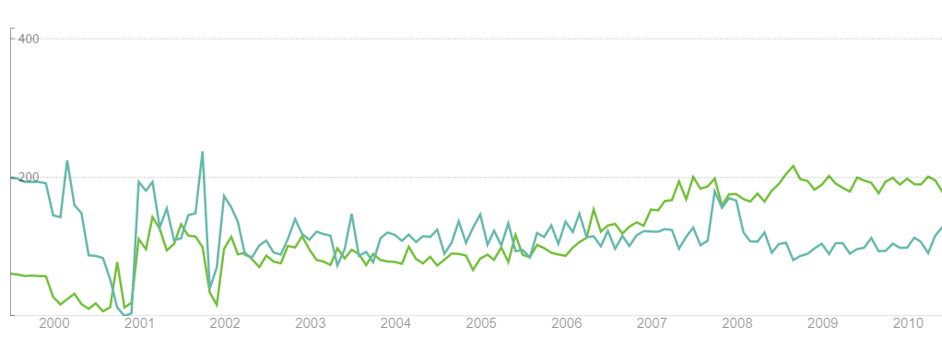
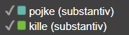
Korp – trend diagram: language change

Slide 17
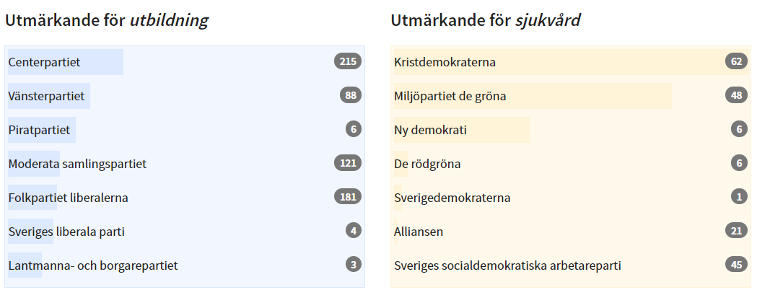
Korp – comparisons (based on probabilities)
Which parties focus on education and which focus on health care in their programs and manifestos?

Slide 18
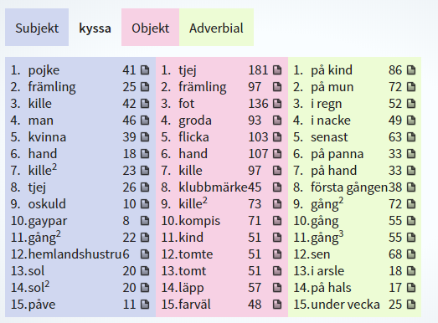
Korp – word pictures
Who kisses whom/what in Sweden, and in which way?

Slide 19
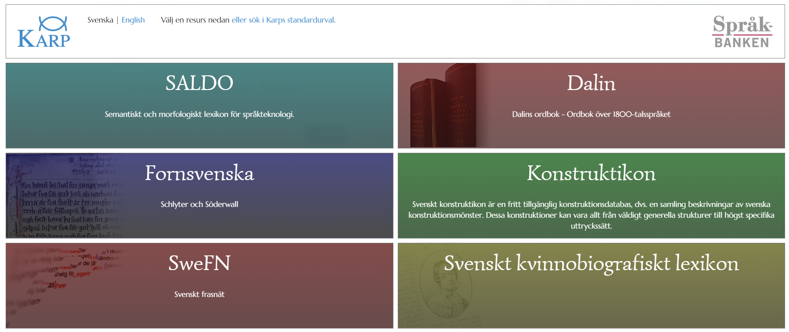
Karp
Karp is a tool for working with Språkbanken’s lexica
https://spraakbanken.gu.se/karp

Slide 20
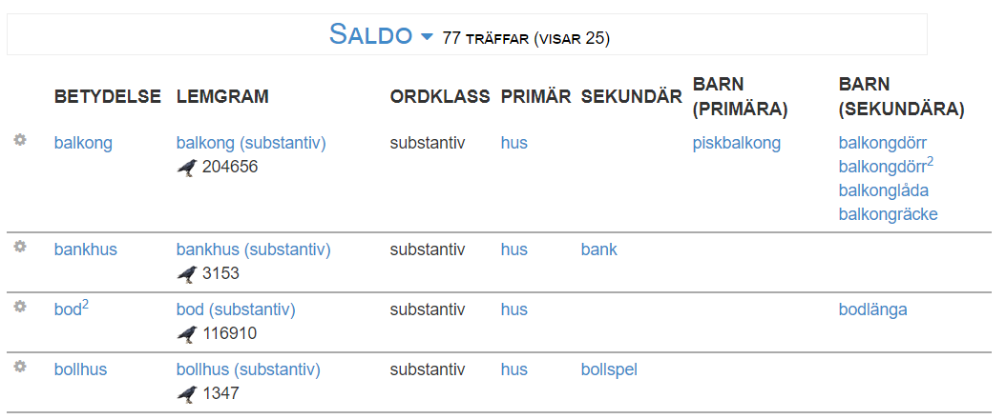
Karp – the Saldo lexicon
How does the semantic neighbourhood look for the word hus?
The search query

Slide 21
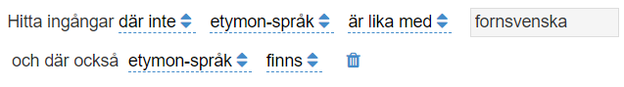
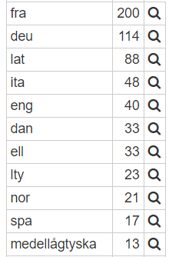
Karp – etymological dictionary
From which languages have Swedish borrowed the most?
Search query: ”find all entries that have specified which language the word comes from, and that language is not Old Swedish”

Slide 22
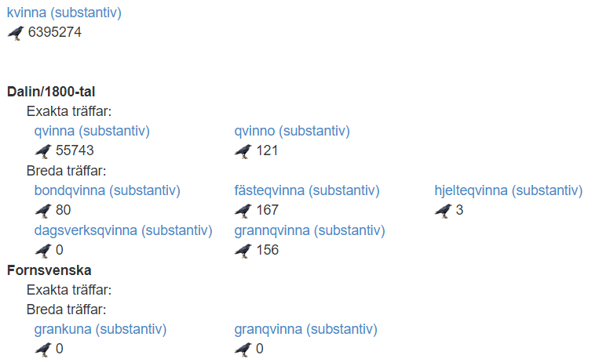
Karp – diachronic pivot
I want to search for the word kvinna in older texts, but I don’t really know how it was spelled during the period I’m interested in

Slide 23
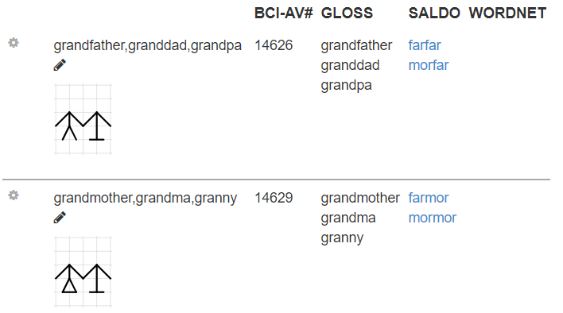
Karp – Blissymbolics
is a semantic graphical language where the where the concepts are represented by ideographic images
Which Bliss-symbols correspond to farfar and mormor?

Slide 24
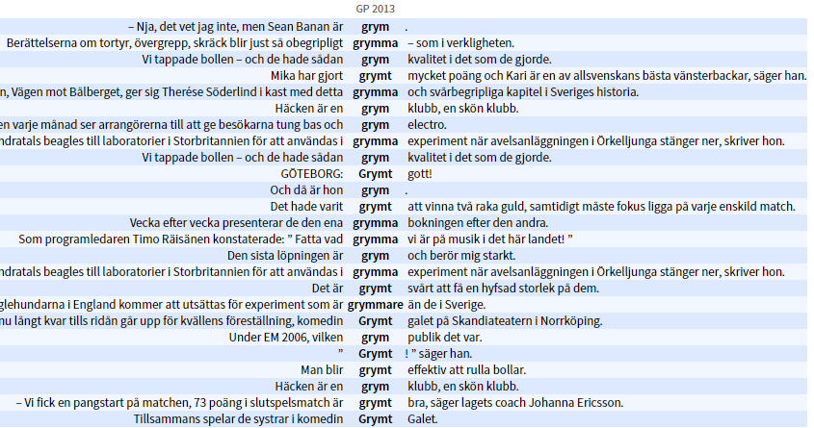
Korp ♡ Karp – automatic text analysis
Let’s search for the word grym in Korp:
Different meanings!

Slide 25
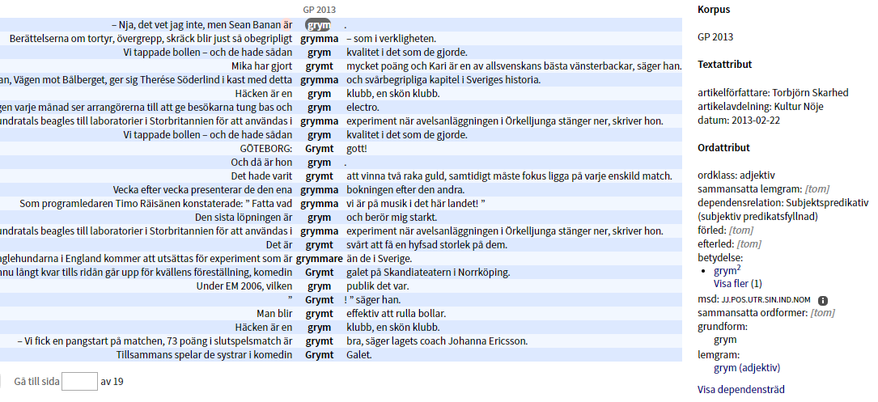
Korp ♡ Karp – the different meanings of grym

Slide 26
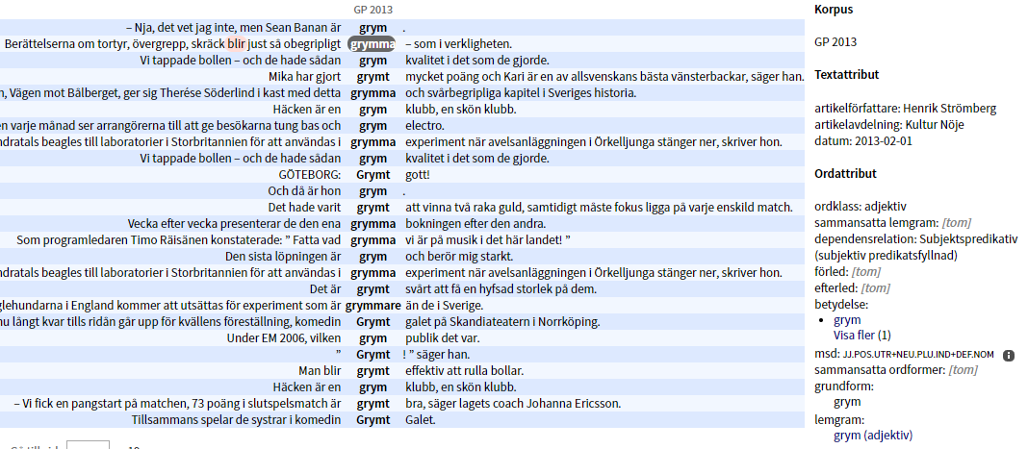
Korp ♡ Karp – the different meanings of grym

Slide 27
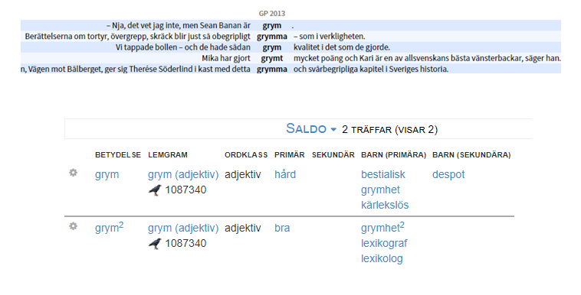
Korp ♡ Karp – the meanings come from Saldo

Slide 28
Sparv
Sparv is a tool that can annotate your texts (both short and long), i.e., provide them with…
lexical analysis
syntactic analysis
semantic analysis
sentiment analysis
readability analys
etc.
https://spraakbanken.gu.se/sparv/

Slide 29
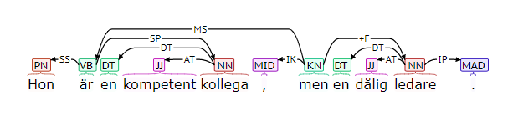
Sparv – syntactic analysis
Hon är en kompetent kollega, men en dålig ledare.
(Eng: She is a competent colleague, but a bad manager)

Slide 30
Sparv – semantic analysis
Hon är en kompetent kollega, men en dålig ledare.
The word ledare can have at least three meanings:
Meaning | Probability in this context (according to Sparv)
manager | 0,65
electrical conductor | 0,21
editorial | 0,14

Slide 31
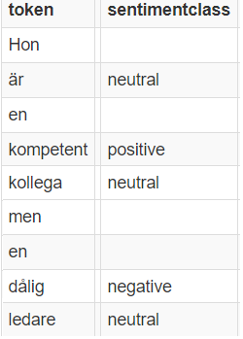
Sparv – sentiment analysis
Hon är en kompetent kollega, men en dålig ledare.

Slide 32
Strix
a search engine that…
doesn’t focus on single words (as Korp does), but on whole documents,
takes the semantic content of the text into account,
can be said to be something in between Korp and Google,
is still under development.

Slide 33
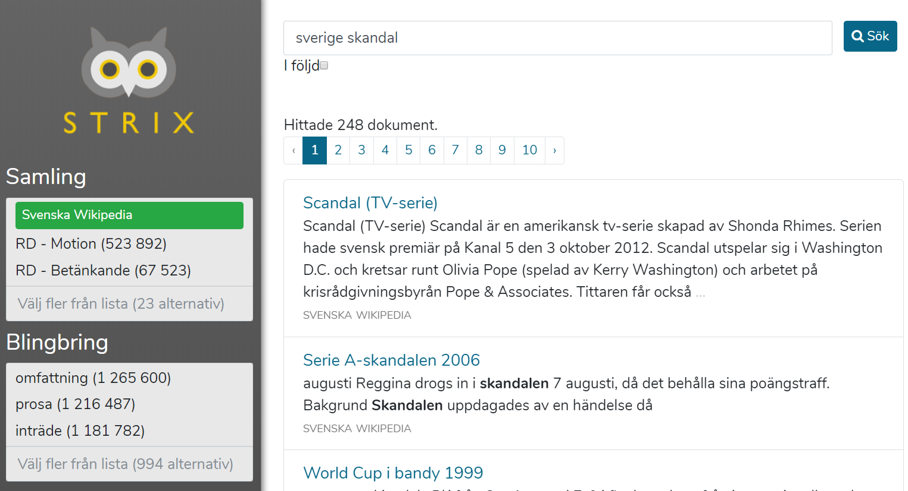
Strix – searching for a document
Search query
search filter

Slide 34
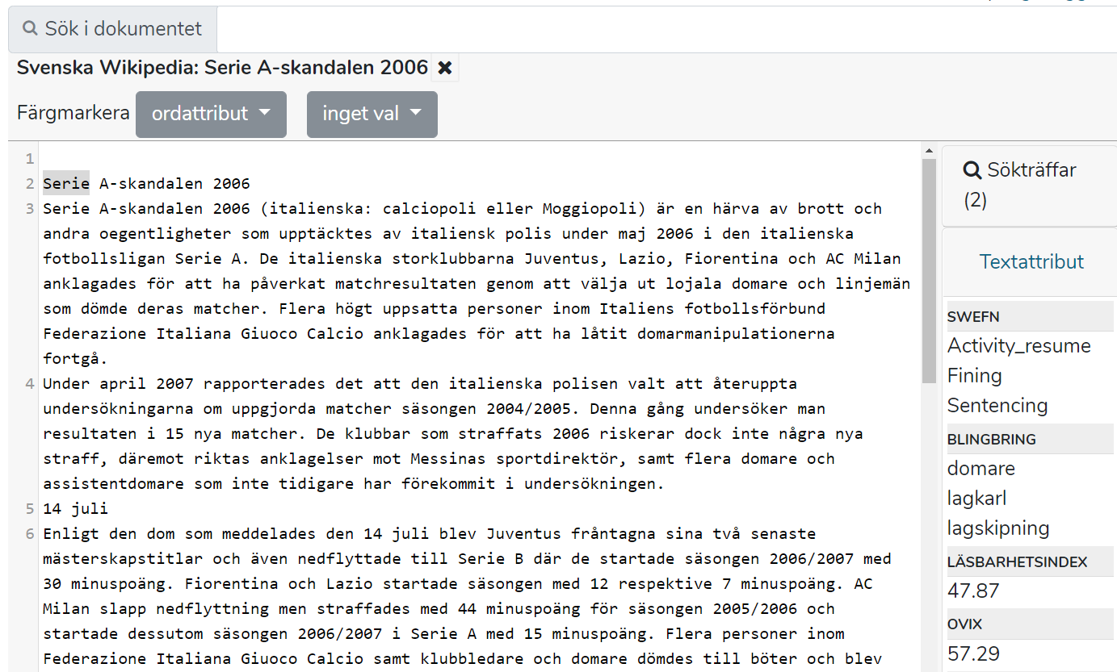
Strix – searching within a document
Sparv figures out the main themes of the text

Slide 35
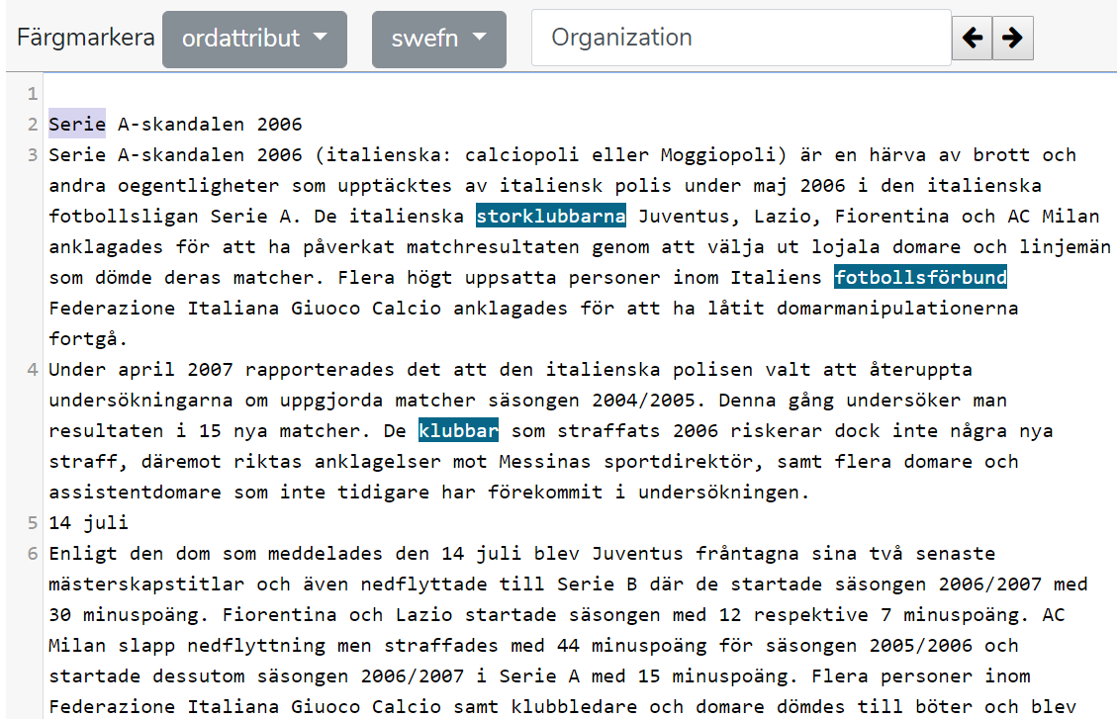
Strix – searching within a document
Show all words that denote organisations

Slide 36
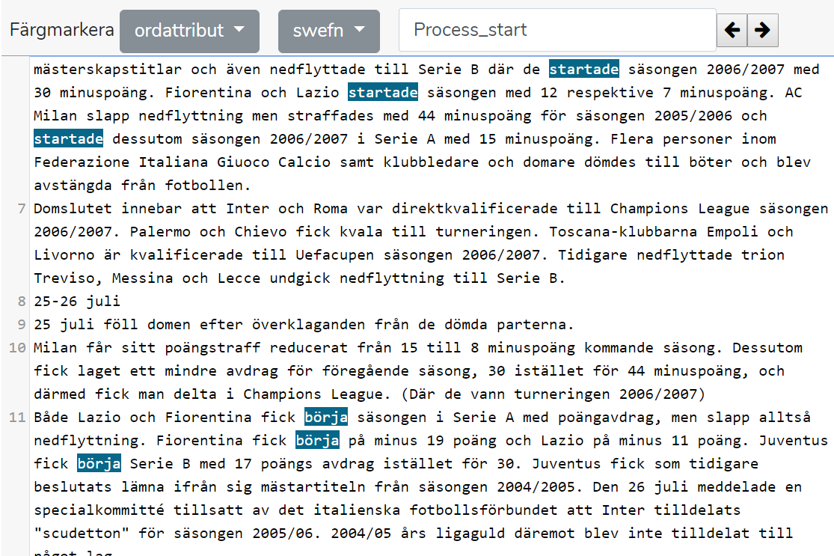
Strix – searching within a document
Show all words that denote the start of a process

Slide 37
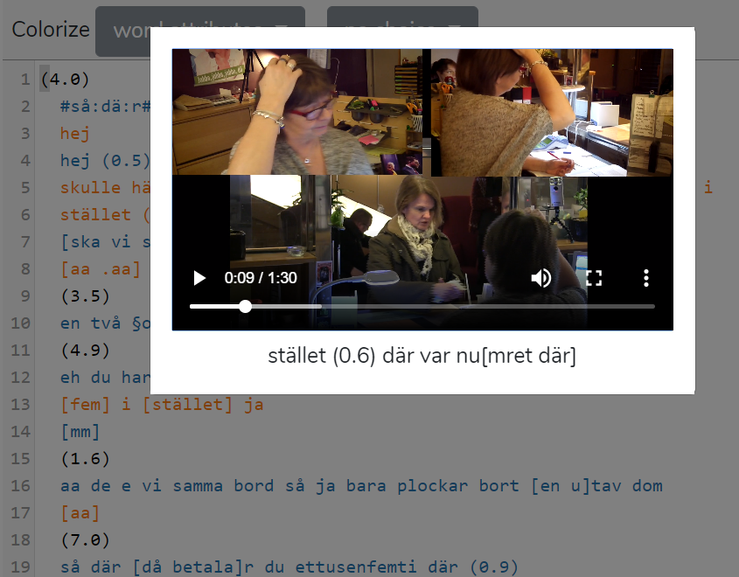
Strix – multimodal corpora
For some data (e.g., recordings of conversations), one can get access to audio and video sources

Slide 38
Lärka
Lärka (LÄR språket via KorpusAnalys) is a learning platform and research tool. Lärka is able to…
generate exercises for language learners
find relevant examples
assist in assessing…
student essays
text difficulty
etc.
https://spraakbanken.gu.se/larka/

Slide 39
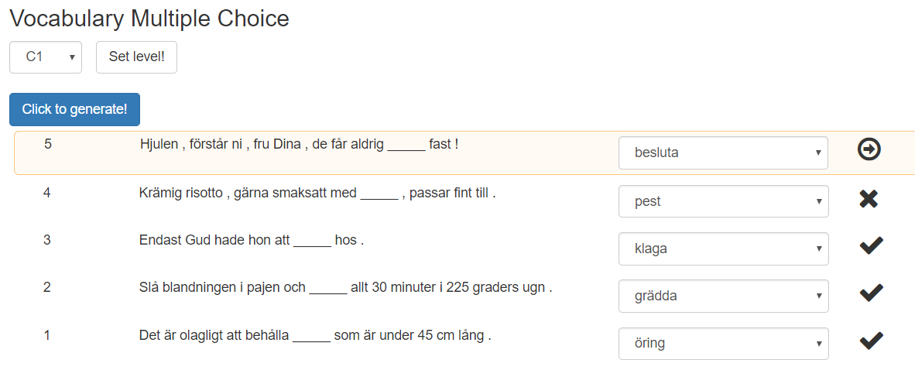
Lärka – generate exercises…
…and correct the answers automatically!

Slide 40
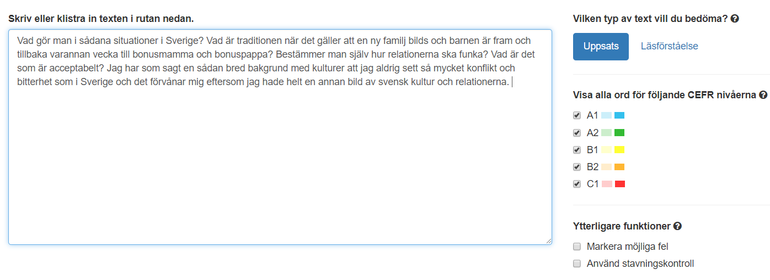
Lärka – assess texts

Slide 41
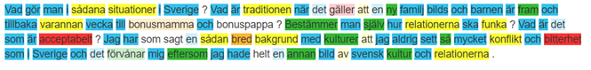
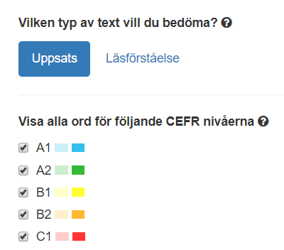
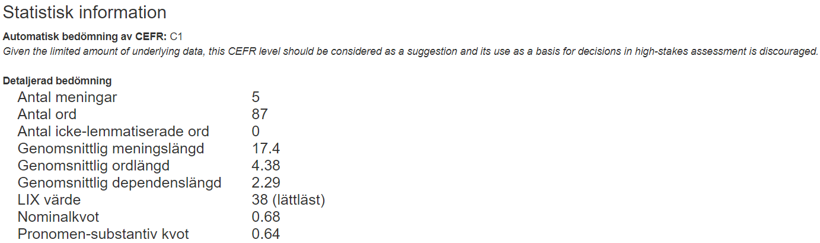
Lärka – assess texts

Slide 42
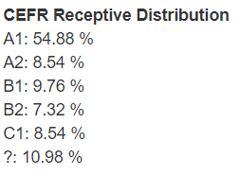
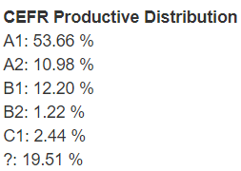
Lärka – results

Slide 43
Installing the tools for yourself
Most of our tools are open source
Korp, Karp and Sparv can be used through an API
Sparv can be installed as a command-line pipeline
Korp can be adapted to other corpora and other languages, and is currently being used in Norway, Finland, Denmark, Iceland, Estonia and Italy

Slide 44
The need for more data – open data
The usefulness of our tools depend on good annotations
Manual annotation is expensive
so only few resources are manually annotated
most of our data is automatically annotated
to be able to do that we need good NLP models
The quality of the data impact the quality of the models
We need all kinds of text data for training different models
newspaper texts
social media, discussion forums
official publications, reports, informational web pages, etc.
blog posts, personal web pages, etc.

Slide 45
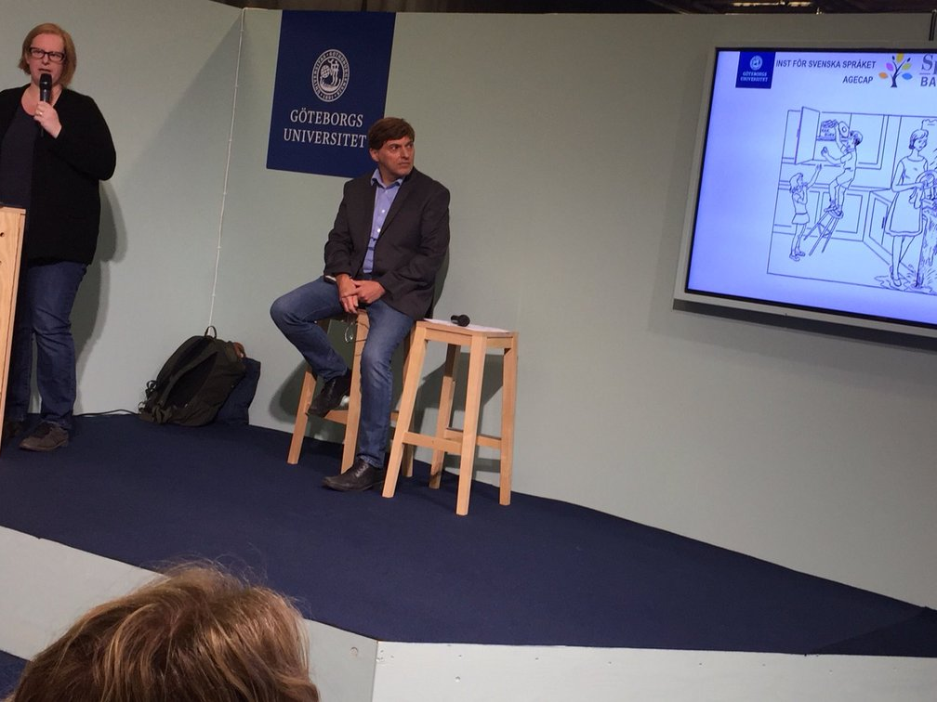
Some examples of our research
Photo: Elena Volodina

Slide 46
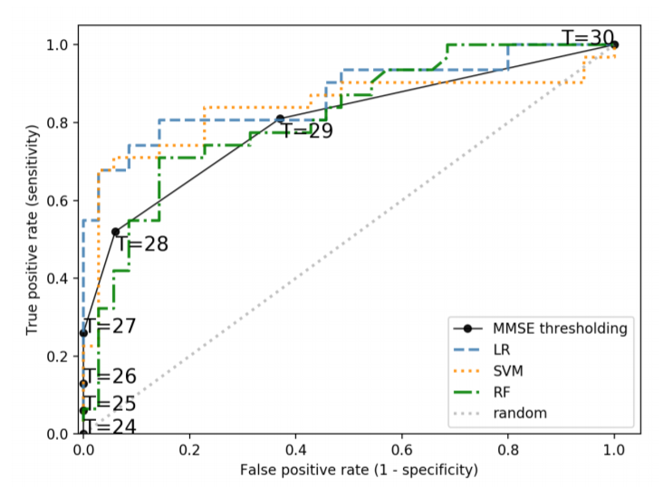
Language technology supports medical diagnostics
A common test that is used for diagnosing mild cognitive impairment (MCI) has the accuracy (“AUC score”) 68%
If we enhance the test with automatic analysis of the patient’s language, the accuracy is improved to 87%
Fraser, Lundholm Fors, Eckerström, Themistocleous, and Kokkinakis (2018). Improving the sensitivity and specificity of MCI screening with linguistic information

Slide 47
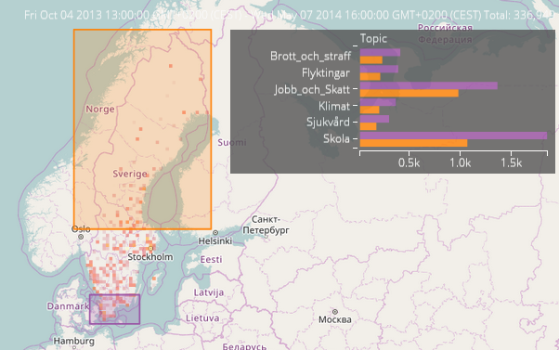
What are Swedes discussing on Twitter right now?
Orange vs purple: hur mycket is the theme discussed in northern vs southern Sweden.
Borin and Kosiński (2016). Towards interactive visualization of public discourse in time and space

Slide 48
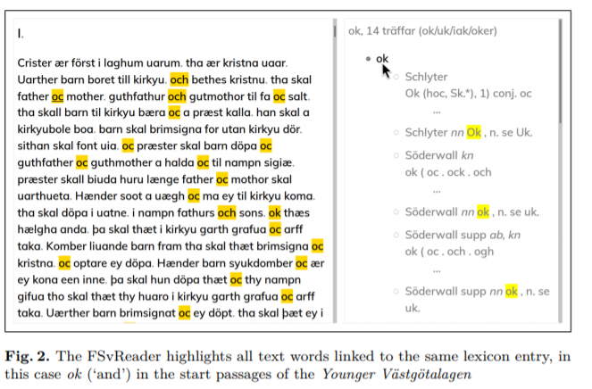
Simplifying the reading of historical texts
Adesam, Ahlberg and Bouma (2018). FSvReader – Exploring Old Swedish cultural heritage texts

Slide 49
Etcetera
How can one see the growth of the consumer society in older Swedish novels (1830–1860)?
Grammar books contain valuable information on thousands of languages. Can this information be extracted automatically?
How can data science and language technology be used to analyse language change and societal change over time?
https://spraakbanken.gu.se/swe/forskning
https://spraakbanken.gu.se/swe/publikationer

Slide 50
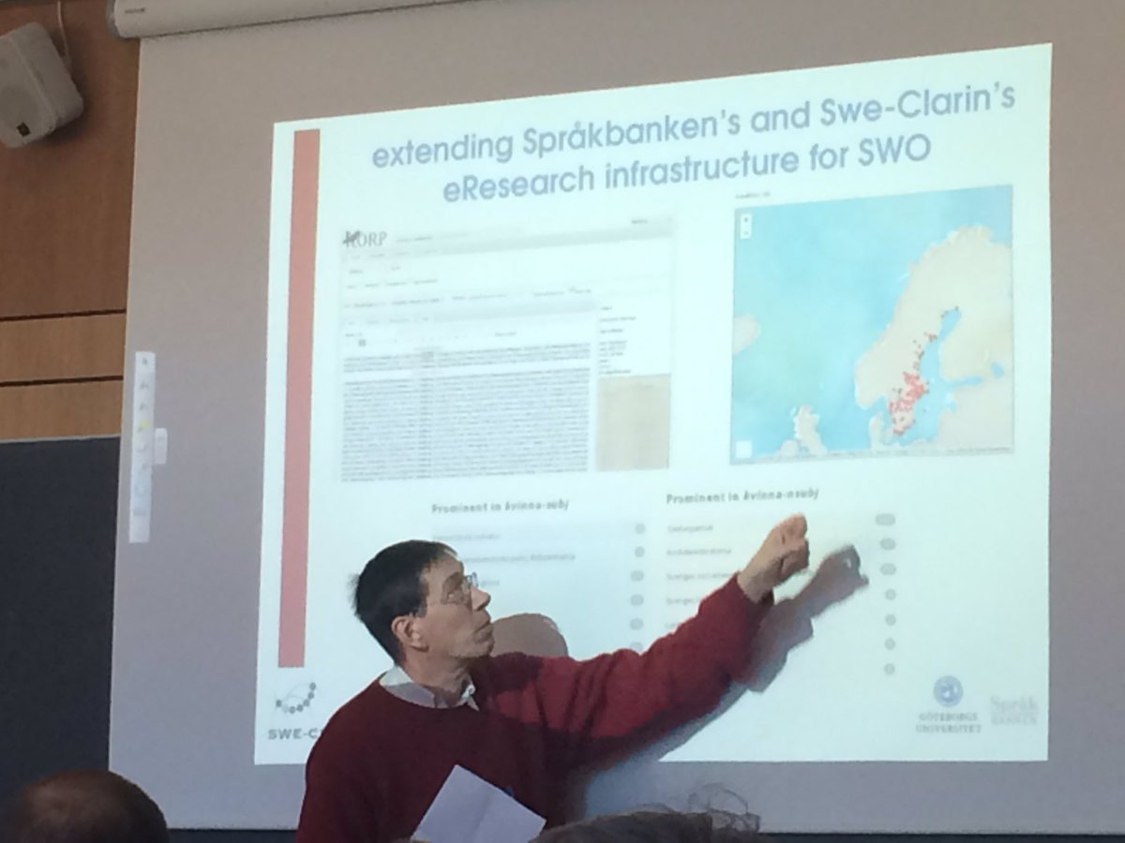
TODO To do together
Foto: Johanna Berg

Slide 51
Things we do
We educate in language technnology
and supervise master theses
We supervise PhD students
https://spraakbanken.gu.se/swe/phd-program
We inform about our resources, our research, and language
workshops
the Språkbanken blog: https://spraakbanken.gu.se/blogg
We answer questions from researchers, and from the public
https://spraakbanken.gu.se/swe/info

Slide 52
Things we can do, todo to do
We can organise a workshop to help you or your students to get started with Språkbanken and language technology
We can help you to use Språkbanken for your own research
We can cooperate with you to find new research problems

Slide 53
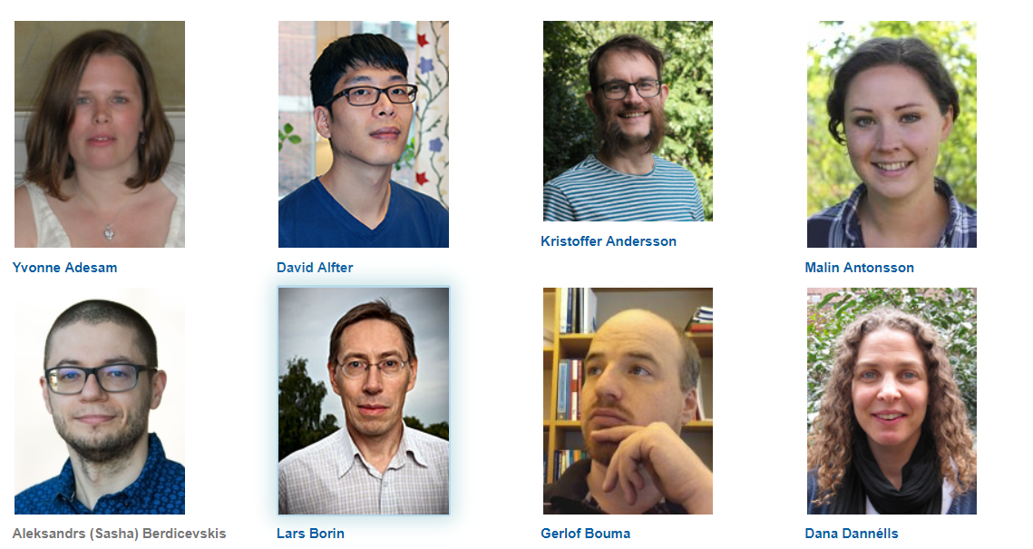
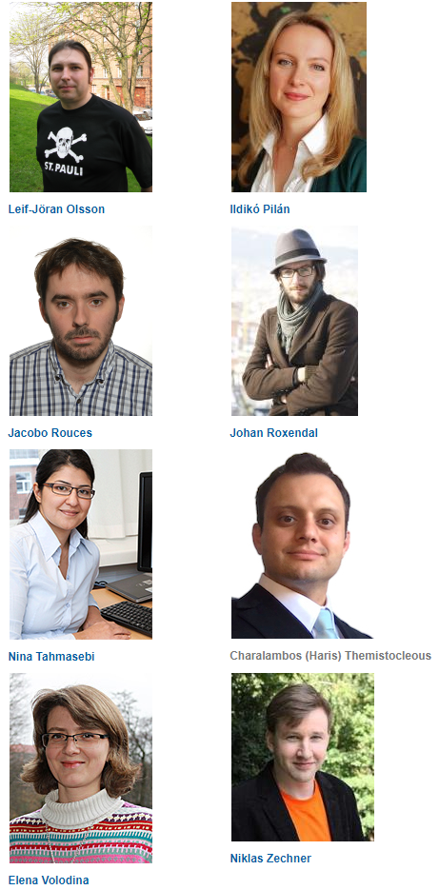
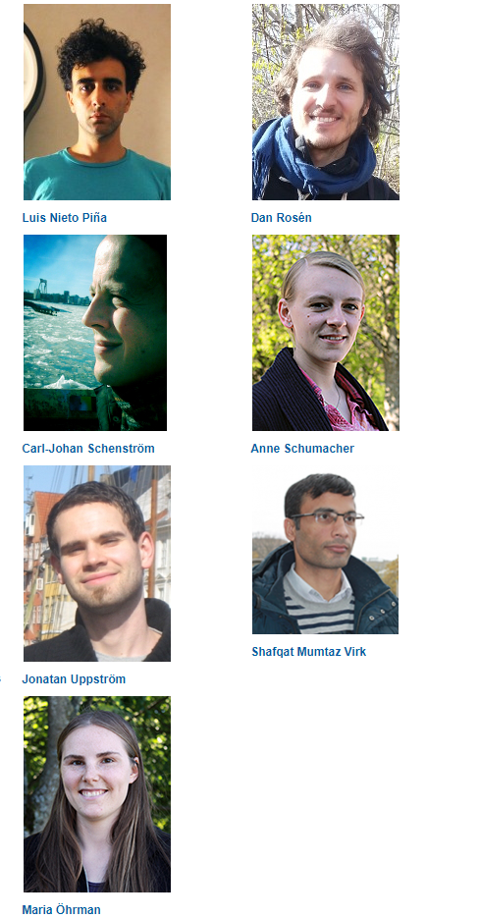
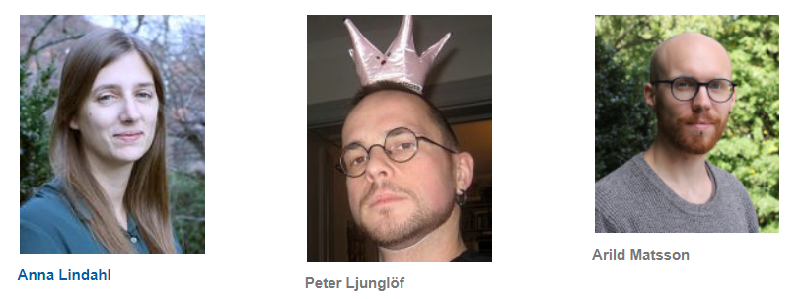
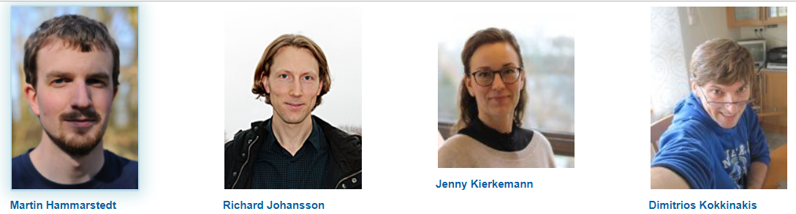
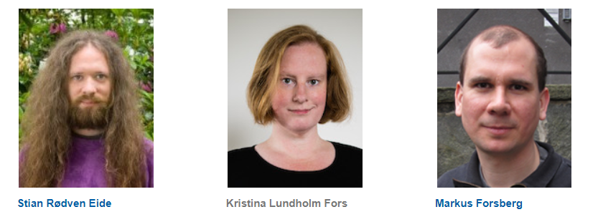
Contact https://spraakbanken.gu.se/ sb-info@svenska.gu.se

